Slide 1
Supreme Court of Appeals of West Virginia Fiscal Year 2023 Budget Presentation

Slide 2
Supreme Court of Appeals
(“SCA”)
5 Justices
SCA Office of Counsel
Office the Clerk
Administrative Office
12 Divisions
Intermediate Court of Appeals
(“ICA”)
3 Judges
ICA Office of Counsel
Probation
Circuit Court
75 Judges
31 Circuits
Family Court
47 Judges
27 Family Ct. Circuits
Treatment Courts
Family Treatment Court
Adult & Juv. Drug Court
Veterans Treatment Court
Magistrate Court
158 Magistrates
55 Counties
Mass Lit. Panel
DV Proceedings
Bus. Court
SLIDE 2 OF 13

Slide 3
Judicial Branch at a Glance
1,473 employees (FY2021 close)
Magistrate Courts - 450
Probation - 383
Circuit Courts - 298
Family Courts - 141
Administration - 101
Supreme Court - 62
Grant Funded - 38
Specialized Courts
Treatment Courts
Adult Drug Courts
Juvenile Drug Courts
Veterans Treatment Courts
Family Treatment Courts
Mass Litigation Panel
Business Court
SLIDE 3 OF 13

Slide 4
Supreme Court Fiscal Year 2023 Budget Request Court Administration Employees (123)
SLIDE 4 OF 13

Slide 5
Supreme Court of Appeals Appropriation Request History
Fiscal Year | Personal Services & Employee Benefits | Other Expenses | Total |  | Enrolled Budget Bill
2018 | $ 101,924,358 | $ 39,835,321 | $ 141,759,670 |  | SB 1013
2019 | $ 102,856,258 | $ 36,903,412 | $ 139,759,670 |  | SB 152
2020 | $ 110,767,344 | $ 13,555,000 | $ 124,322,344 | * | HB 2020
2021 | $ 111,440,000 | $ 24,060,000 | $ 135,499,000 | ** | SB150
2022 | $ 115,126,000 | $ 23,837,000 | $ 138,963,000 |  | HB 2022
2023 | $ 120,611,275 | $ 25,706,751 | $ 146,318,026
*The FY 2020 budget request was voluntarily reduced by $10 million. Sufficient reappropriated funds were available to meet spending needs in FY 2020.
**The FY 2021 expenditures were $131.2 million prior to CARES Act reimbursement of $11.4 million.
SLIDE 5 OF 13

Slide 6
Fiscal Year 2023 Appropriation Request
SLIDE 6 OF 13

Slide 7
Supreme Court Fiscal Year 2023 Personal Services & Benefits: 82.4% of Judicial Branch Budget
SLIDE 7 OF 13

Slide 8
Supreme Court Fiscal Year 2023 General Revenue Appropriation Request $146.3M
Administrative costs include personal services costs for AO staff.
Also, costs not directly allocated to other areas such as
1. BRIM Premium
2. Workers’ Comp Premium
3. Judicial Retirement Contribution
4. wvOASIS User Fee
5. Software Licenses
6. Law Library Purchases
SLIDE 8 OF 13

Slide 9
SLIDE 9 OF 13

Slide 10
Supreme Court Fiscal Year 2023 Increase
5% more than current FY
Reasons:
Judicial pay raises enacted by the Legislature (SB 597)
Anticipated increase in GAL costs (W. Va. Code § 59-2-1)
Merit-based pay raises based on years of service and/or educational achievements
Creation of the Intermediate Court of Appeals (SB 275)
SLIDE 10 OF 13

Slide 11
Intermediate Court of Appeals Budget Update
Division of Regulatory and Fiscal Affairs Fiscal Note:
$5,159,564 Year 1 Costs for Supreme Court
FY23 Budget Request:
$5,084,026 Year 1 Costs
Budget Request is $75,000 less than estimate
No new money appropriated for FY22, but the Court absorbed those costs from existing budget
SLIDE 11 OF 13

Slide 12
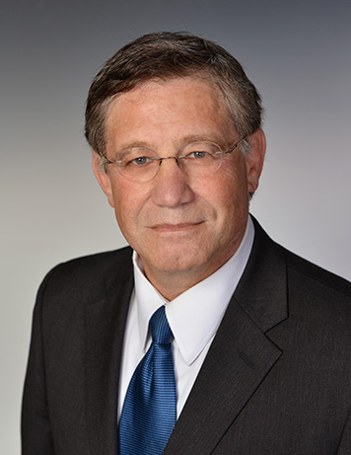
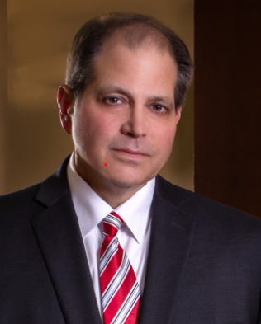
Intermediate Court of Appeals Status Update
ICA Judge Appointee Thomas Scarr
ICA Judge Appointee Daniel Greear
ICA Judge Appointee Donald Nickerson, Jr.
SLIDE 12 OF 13

Slide 13
Supreme Court of Appeals of West Virginia Fiscal Year 2023 Budget Presentation

